Slide 1
Hand Written Digit Recognition
© Templateswise.com
A H M Zobyer 201714013
Ariful Islam Tarek 201714030

Slide 2
Features
Recognize the Hand Written Digit
Converting Digit into Speech

Slide 3
Dataset
Digit is written using Microsoft paint
Total dataset contains 1000 images where each digit has 100 images
Number of image will increase further for more accuracy

Slide 4
Image Processing Methods
Image is converted Into several steps
Grayscale Conversion
Gaussian Blur
Image Resize(28*28 pixels)
Pixel Conversion

Slide 5
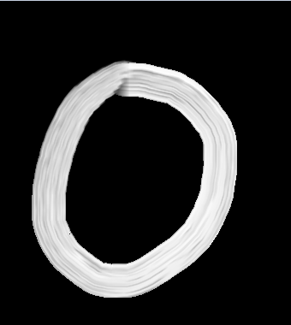
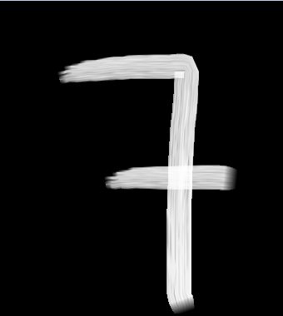
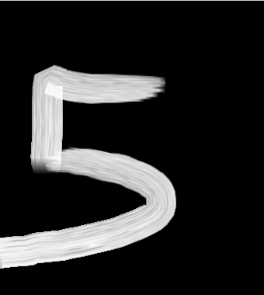
Sample Dataset

Slide 6
Tools & Technologies
Language
Python
Algorithm
Support Vector Machine(SVM)
Editor
Jupyter Notebook
Libraries
Numpy
Pandas
Sklearn
Pyttsx3
Inflect
Joblib
CSV
Glob

Slide 7
THANKU!

